Slide 1

3D Vision LLM
3D OBJECT CAPTIONING - WEEK #1
7-25-2024
Submitted by:
Mr. FAZZA Abdellah - ENSAM Casablanca (Big Data & IoT)
3D SMART FACTORY

Slide 2

Plan
Overview and Objectives
Applications
State of the Art
Methodology
Related Works
Challenges

Slide 3
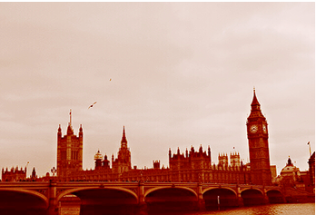
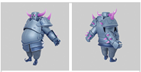
Overview and Objectives
3D Model Captioning involves creating a system that can interpret the features of a 3D object and describe it in human language. Unlike traditional image captioning, which deals with 2D images, this project tackles the challenge of understanding and describing three-dimensional structures.
This capability is crucial for various applications, such as enhancing virtual reality experiences, assisting in inventory management, and improving human-computer interaction.
A view of a bridge with a clock tower over a river
3D model of an armored character with purple horns and spikes on the back

Slide 4
Overview and Objectives
The primary goals of this project are:
Learn as much as I can about 3D Vision, LLms, 3D Objects and pre-trained models.
Develop a robust model that can accurately generate descriptions for individual 3D models.

Slide 5
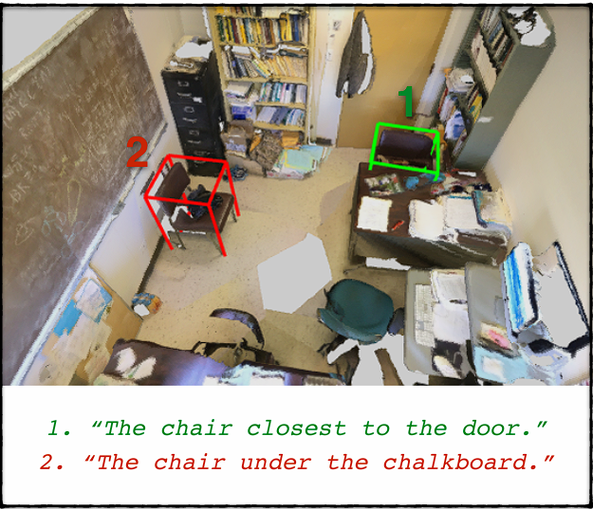
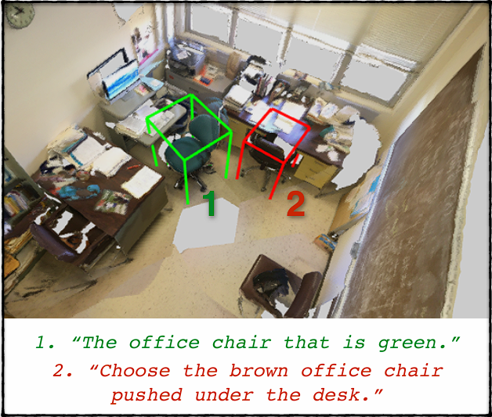
State of the Art
ReferIt3D: Neural Listeners for Fine-Grained 3D Object Identification in Real-World Scenes

Slide 6
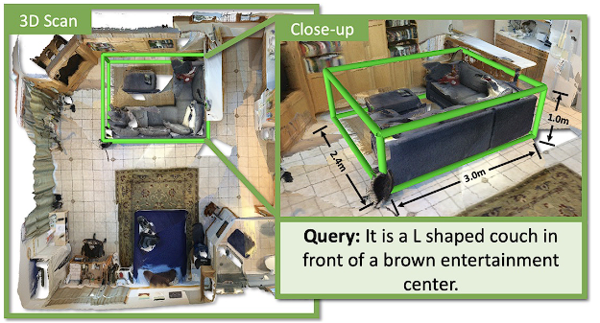
State of the Art
ScanRefer: 3D Object Localization in RGB-D Scans using Natural Language

Slide 7
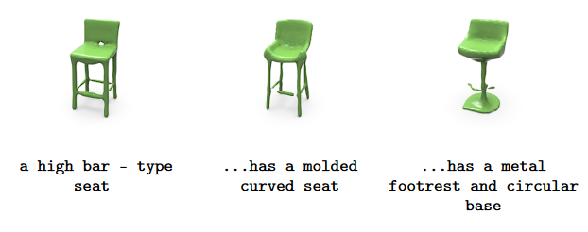
State of the Art
ShapeCrafter: A Recursive Text-Conditioned 3D Shape Generation Model

Slide 8
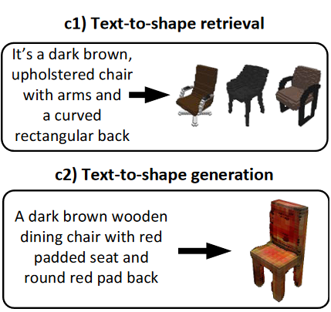
State of the Art
Text2Shape: Generating Shapes from Natural Language by Learning Joint Embeddings

Slide 9

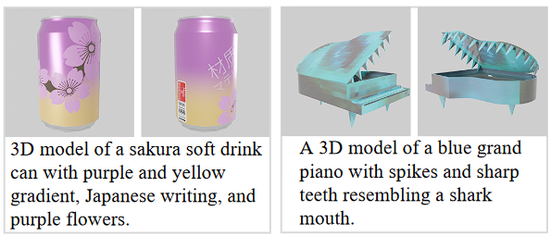
Related Works
Scalable 3D Captioning with Pretrained Models

Slide 10
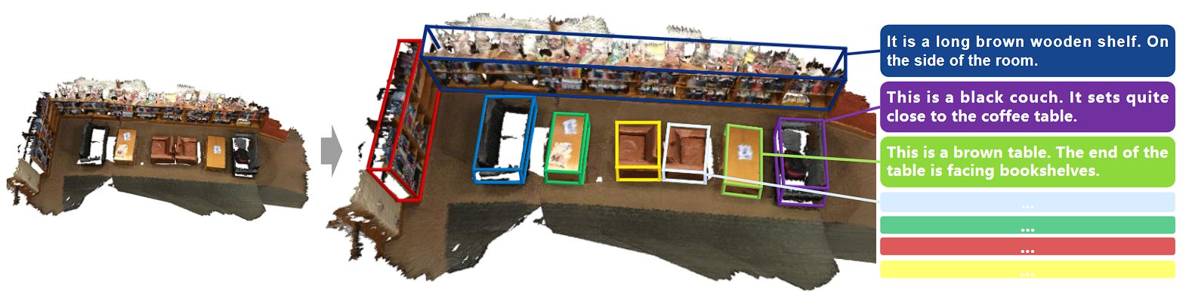
Related Works
A Comprehensive Survey of 3D Dense Captioning: Localizing and Describing Objects in 3D Scenes

Slide 11
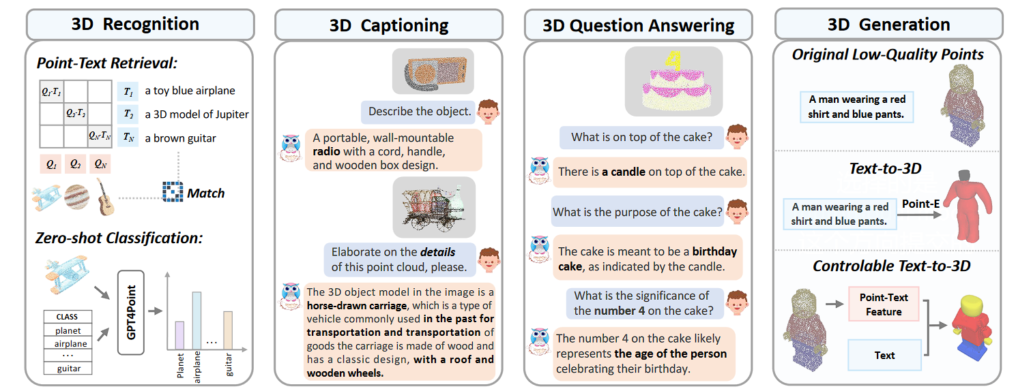
Related Works
GPT4Point: A Unified Framework for Point-Language Understanding and Generation

Slide 12
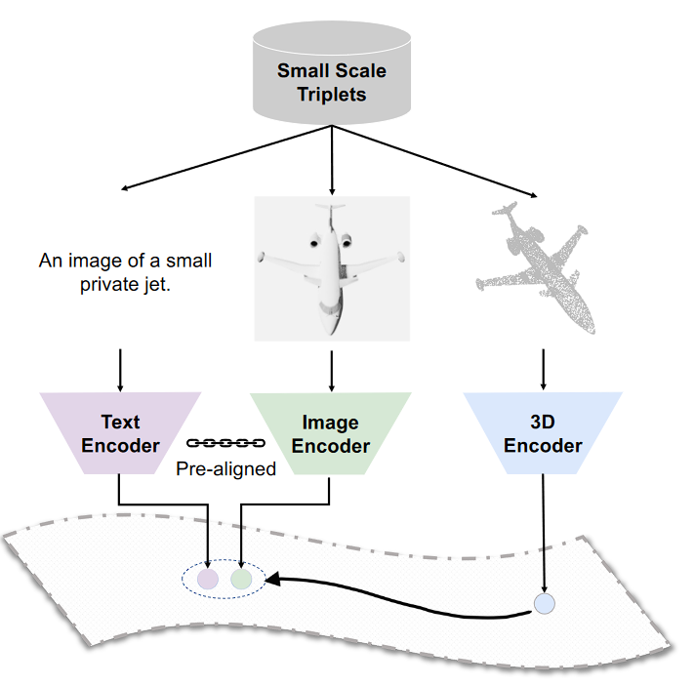
Related Works
ULIP: Learning a Unified Representation of Language, Images, and Point Clouds for 3D Understanding

Slide 13


Helping visually impaired individuals by describing their surroundings
ACCESSIBILITY
AR/VR
Improving user experience in augmented and virtual reality by providing descriptive content
ROBOTICS
Applications
Enhancing robotic perception and interaction in 3D environments
AUTONOMOUS SYSTEMS
Assisting autonomous systems in interpreting and navigating 3D spaces

Slide 14







3D-FUTURE: 3D Furniture shape
ABO
Methodology
The 3D-FUTURE dataset is a richly-annotated, large-scale repository of 3D furniture shapes with high-resolution textures and detailed geometries,
The Amazon Berkeley Objects (ABO) dataset is a large-scale collection of product images, metadata, and artist-created 3D models with complex geometries and materials.
Data Collection
Cap3D
Objaverse
Objaverse 1.0 is a large-scale dataset of over 800,000 3D models with captions, tags, and animations, designed to improve upon current 3D repositories.
3D-text pairs generated by Cap3D from the paper: Scalable 3D Captioning with Pretrained Models
Datasets
ShapeNet
ModelNet
ShapeNet is a richly-annotated, large-scale repository of over 3,000,000 3D CAD models organized into 3,135 categories under the WordNet taxonomy, featuring semantic annotations like alignments, parts, symmetry planes, and physical sizes.
offers a comprehensive, clean collection of 3D CAD models for objects, organized into common categories derived from the SUN database, with human-verified categorization and alignment.

Slide 15

Methodology
Data Collection
Disclaimer!
The provided datasets are not all publicly available; some require filling out a form to gain access.

Slide 16




Methodology
3D Data
Data Preprocessing
Convert 3D models into a suitable format (e.g., voxel grids, point clouds)
Text Data
Clean and tokenize textual descriptions for training
Ethical Filtering
Ensure the ethical integrity of this dataset.
Remove NSFW content.

Slide 17


Methodology
Model Architecture
Proposed Architecture #1
Proposed Architecture #2

Slide 18
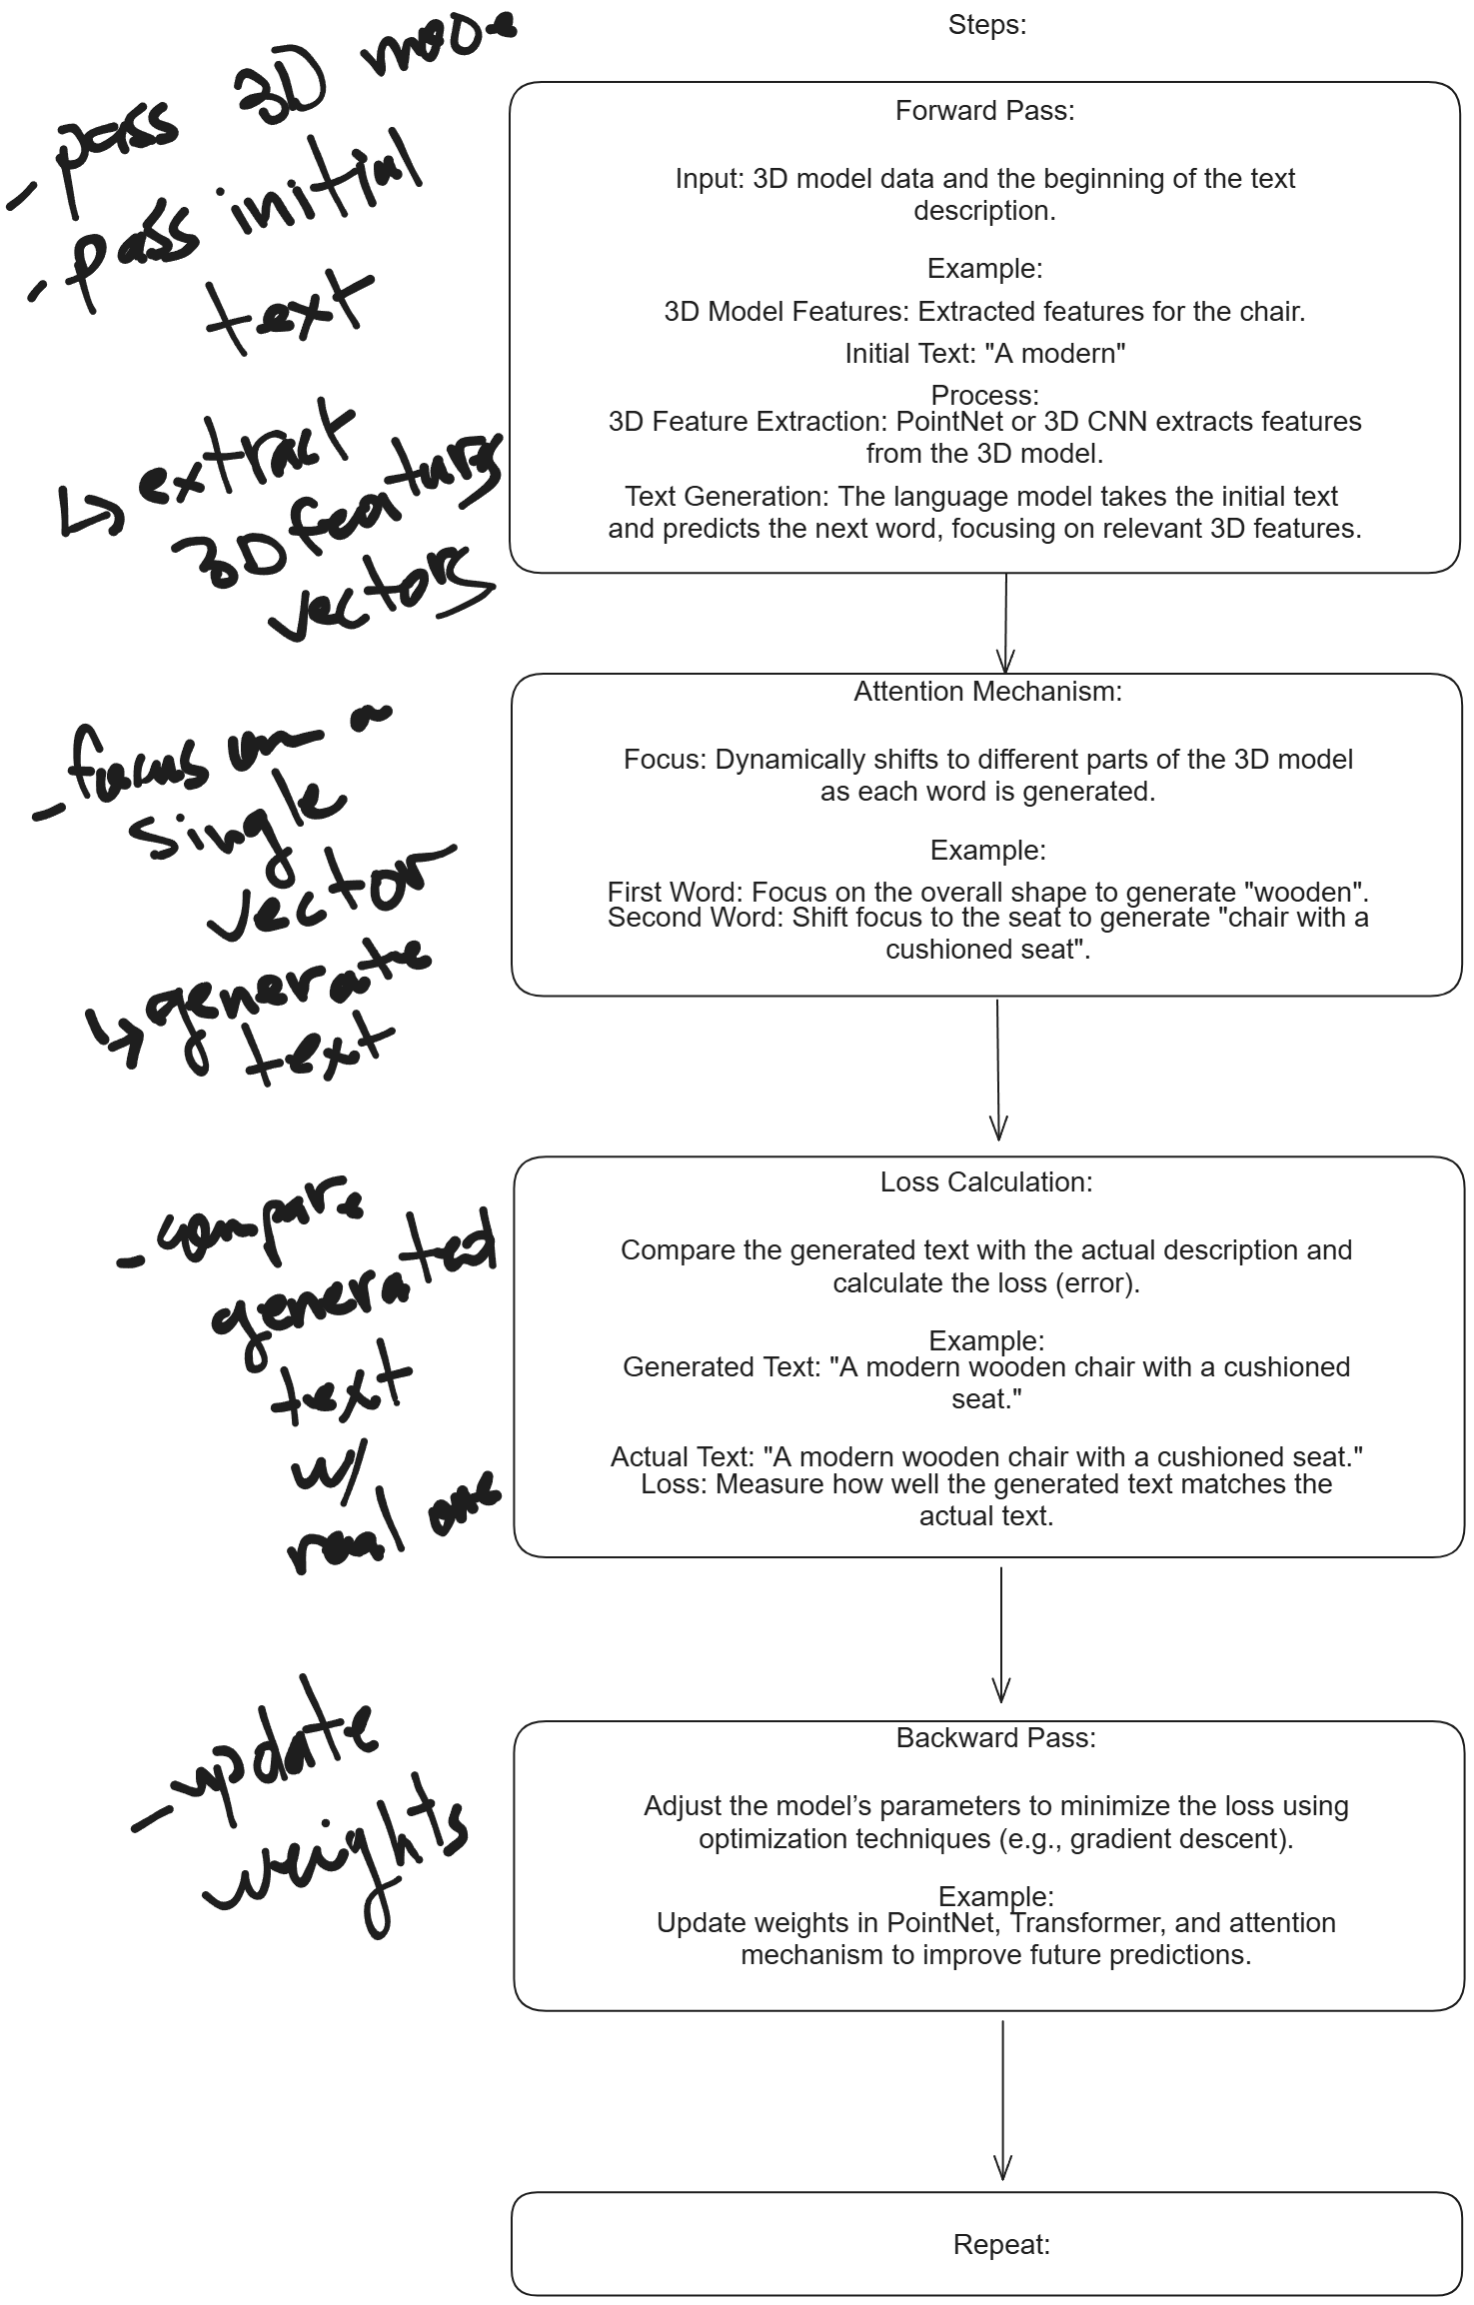
Model Architecture
Proposed Architecture #1 (Supervised Approach)
Page 404

Slide 19
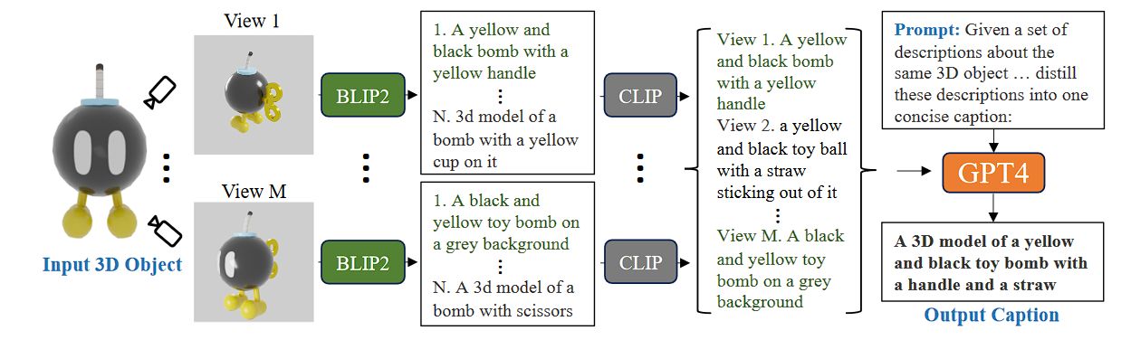
Model Architecture
Proposed Architecture #2
(Inspired by Cap3D)
Rendering -> BLIP2 -> CLIP -> GPT4

Slide 20
Methodology
Training
Evaluation

Slide 21
Challenges (presumed)
Computational Resources
Data Quality

Slide 22

Thank You
for your attention

